Slide 1
Short lectures

Slide 2
Short Lecture: Alignment, reference genomes, denovo assemblies, stacks

Slide 3
First introduce blast, they know this.
But problem is millions of reads, where to they fit?
Explain method
Bwa, bowtie,
But what if we don’t have a genome?
Stacks, ipyrad, ddocent, etc.

Slide 4
Reference genomes are big
We have MANY reads to align
We don’t want exact matches→ why?

Slide 5
Basic approach: seed-and-extend
Take a subset of your sequence (k; usually ~19)
Find the match in the reference genome (seeding)
Try to extend these matches (extending)
You can alter k, shorter = more thorough but slower, longer = less thorough but slower.
bwa-mem
Burrows-Wheeler Alignment → a compression method
Maximal Exact Match→ longest match that can’t be extended further
Most short read aligners use similar approaches

Slide 6
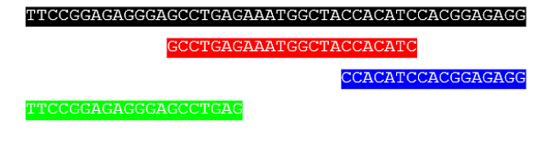
What if I don’t have a genome?
Option 1: Denovo assembly
Best option
Challenging:
Genomes are big
Repetitive
Inversions
Etc
Long reads address these issues
Can also link scaffolds with other methods:
Hi-C, optical mapping, HiRise, etc.
Option 2: Reduced representation
Most commonly RAD-seq
Pseudo reference genome of sorts
Stacks, ipyrad, ddocent, others
Repeat regions:
AACCAACCAACCAACCAACCAACCAACCAACC
By Luongdl - Own work, CC BY-SA 3.0, https://commons.wikimedia.org/w/index.php?curid=32630571

Slide 7
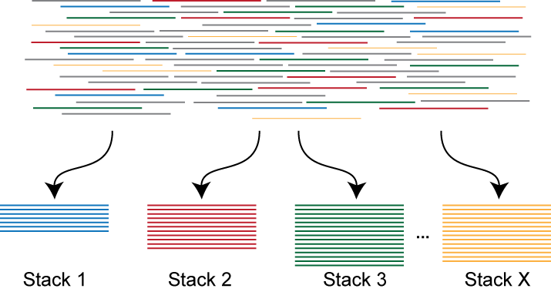
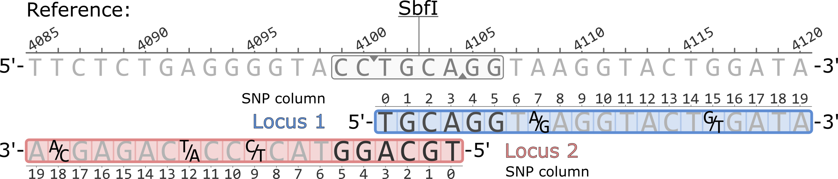
Stacks
Most popular method, good for within species comparisons
Clustering by similarity:
Allow for genetic variation
But not merge different genomic regions
Harder than it seems…
https://catchenlab.life.illinois.edu/stacks/manual/

Slide 8
Short Lecture: Variant calling

Slide 9
Challenge: What is genetic variation, what is an error?
Give some possible examples of sequences
Flipping a coin

Slide 11
Short Lecture: Mapping results, PCR duplicates Properly paired multi-mapping

Slide 12
Short Lecture: Population Structure

Slide 13
Alignment, reference genomes, and denovo assemblies

Slide 14
Short Lecture: Selection Scans

Slide 15
Detecting selection in genomic data
Outlier scans
Basic fst based
More complex:
Bayscan, outflank, etc.
Gene environment associations
Cline analyses
Experimental evolution
Before and after studies
Think hurricanes, sea star wasting, etc.

Slide 16
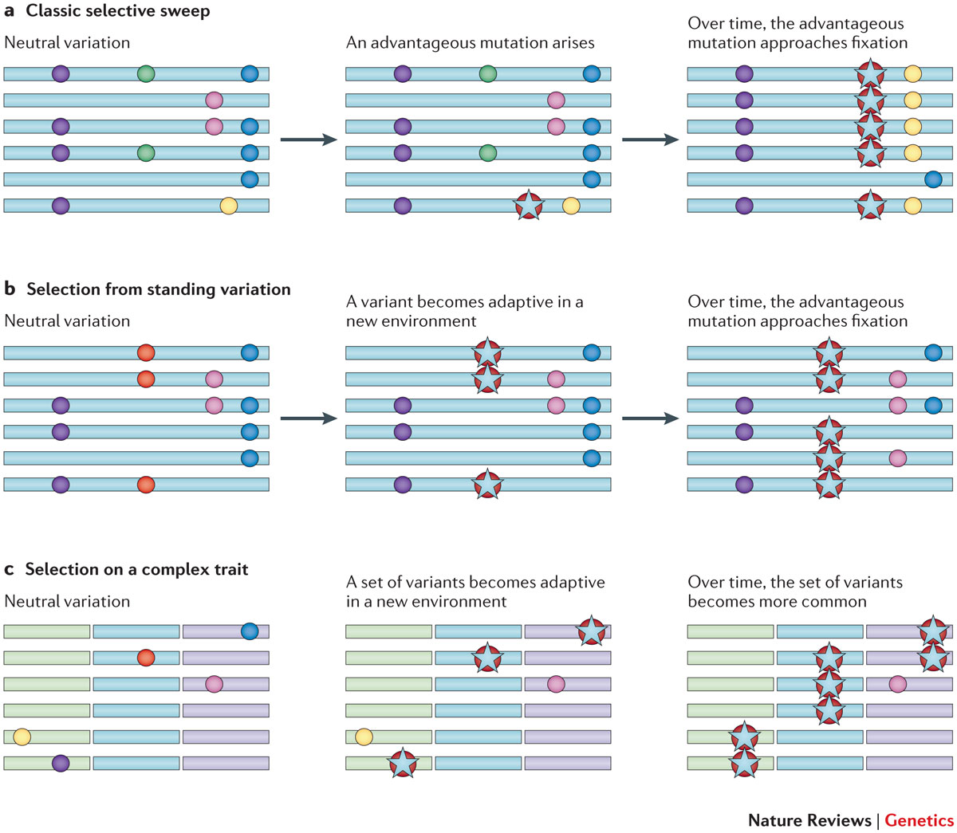
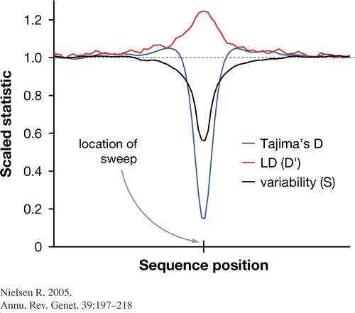
Types of selective sweeps
Elevated: Fst, LD
Decreased: Tajima’s D, genetic diversity

Slide 17
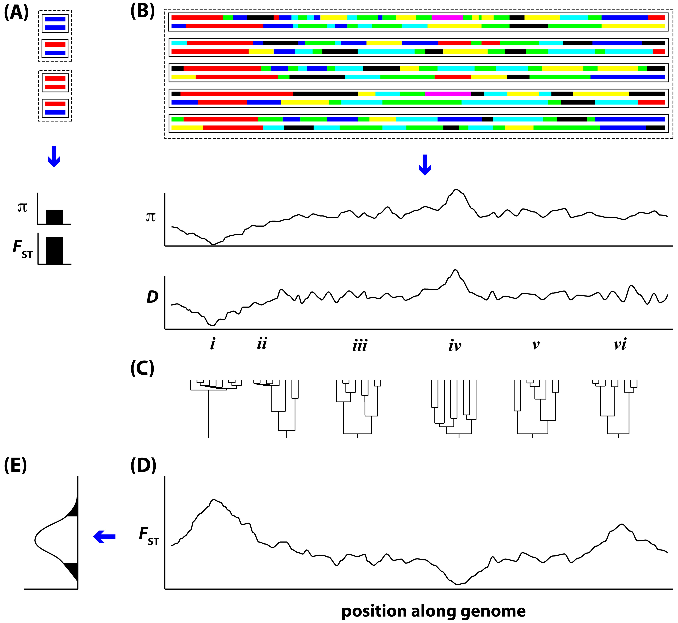
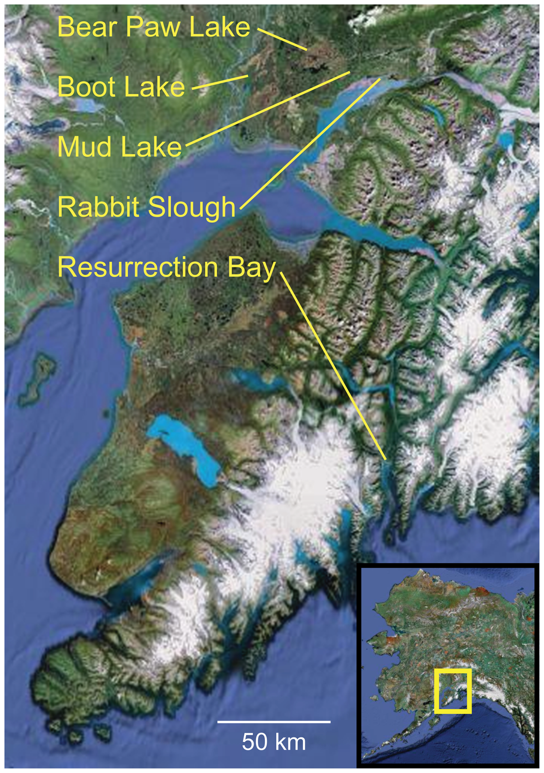
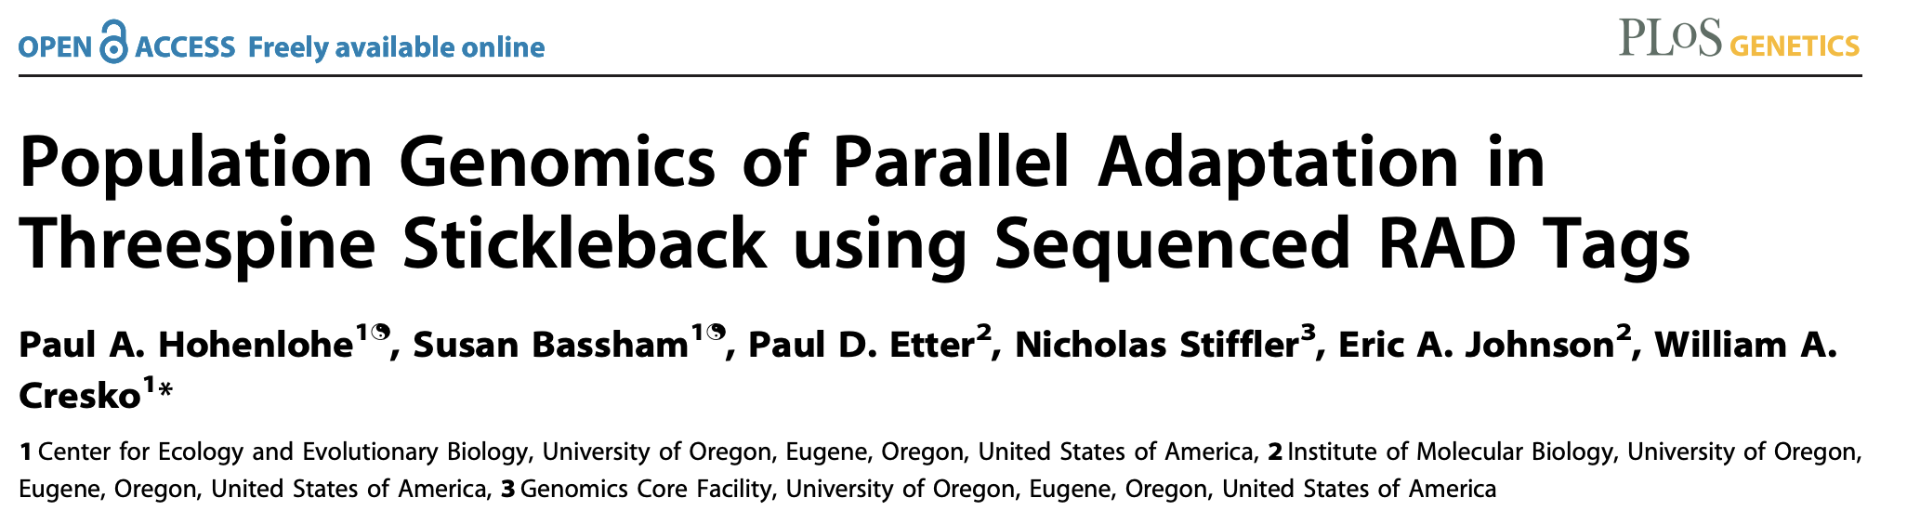
Hohenlohe, Phillips, and Cresko 2010

Slide 18
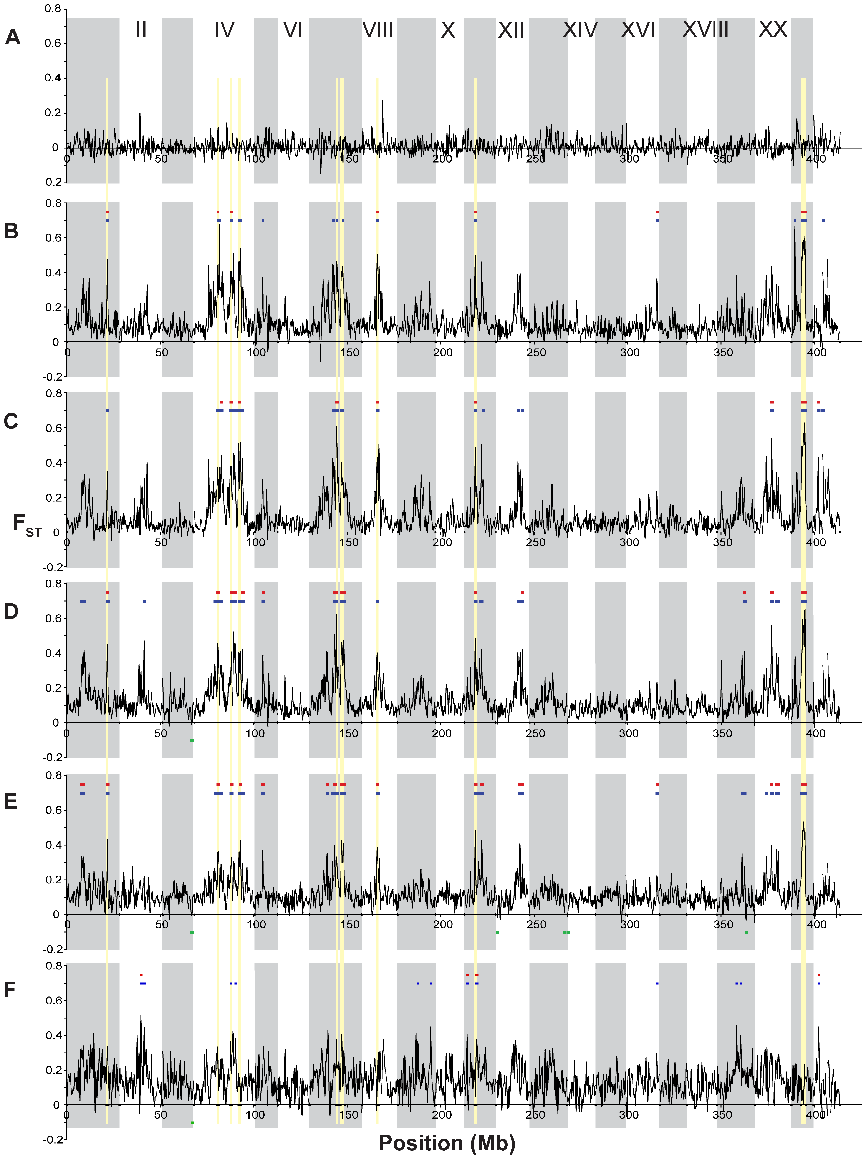
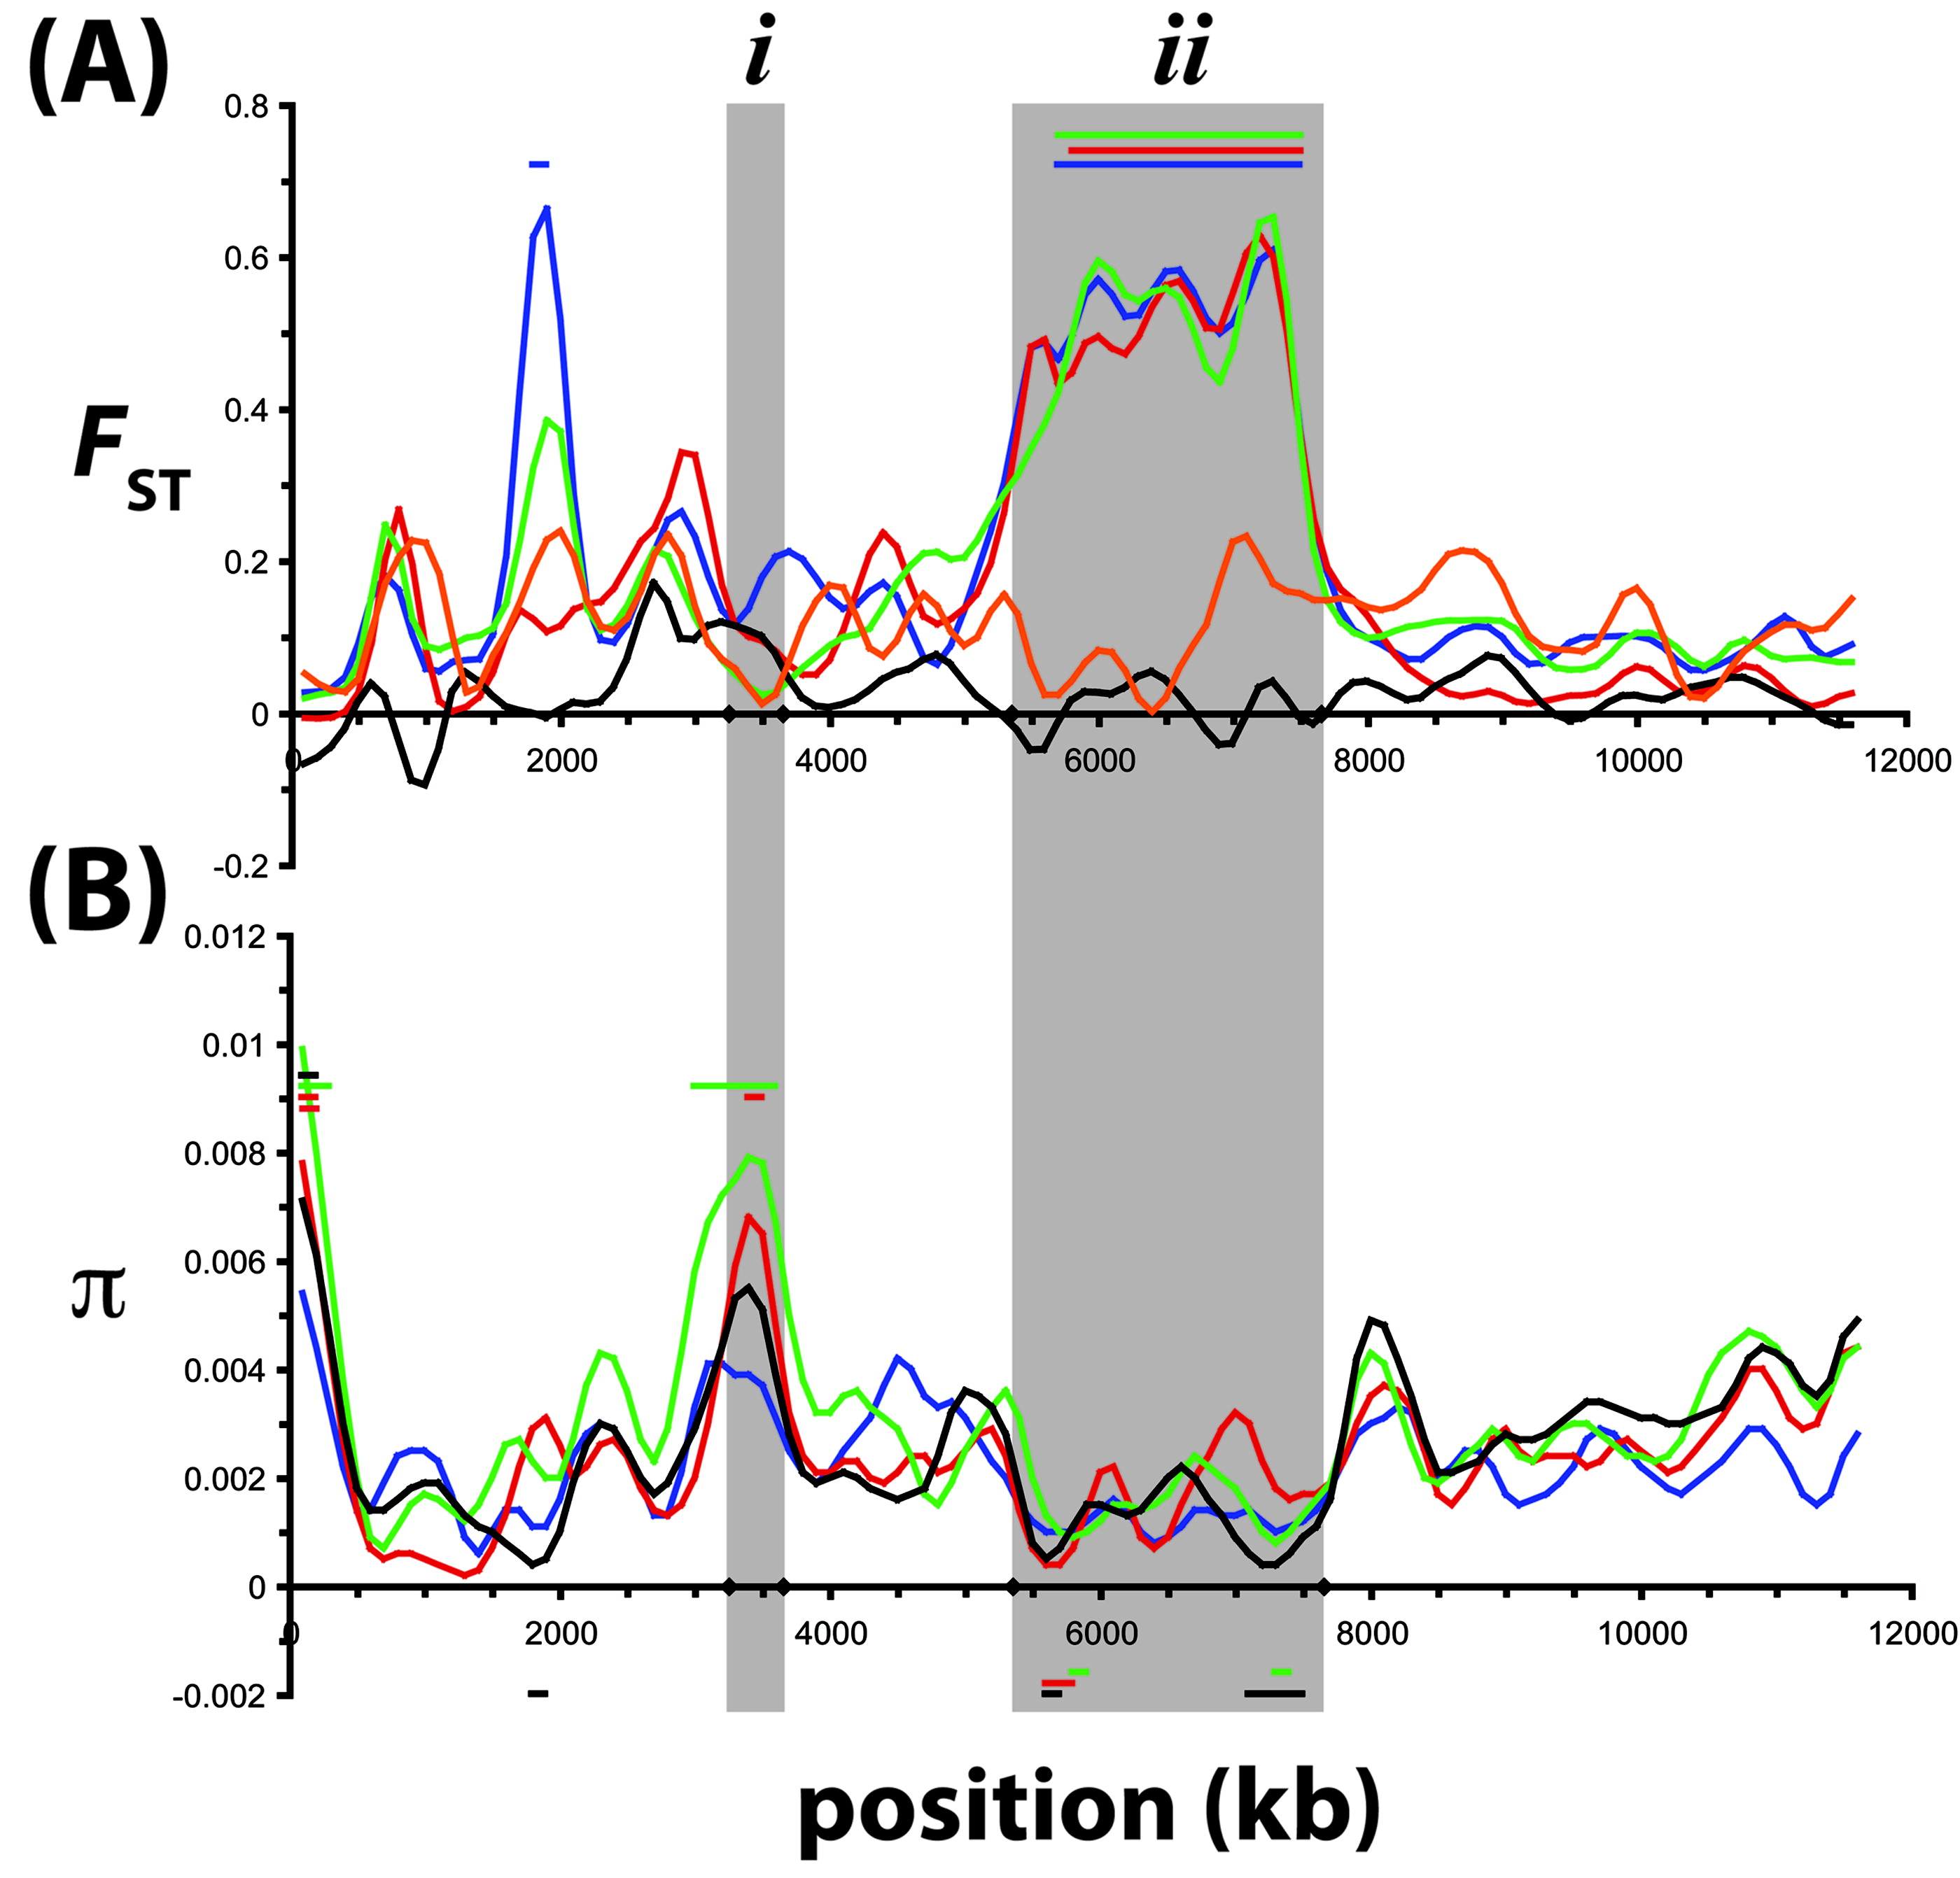
Hohenlohe, Phillips, and Cresko 2010

Slide 19
Detecting outlier regions
What is the null distribution?
How to define “outliers”
Empirical: Tail of the distribution
Fst

Slide 20
Detecting outlier regions
What is the null distribution?
How to define “outliers”
Demographic null
Bayescan
island model in which subpopulation allele frequencies are correlated through a common migrant gene pool from which they differ in varying degrees.
Which loci violate neutrality?

Slide 21
Detecting outlier regions
What is the null distribution?
How to define “outliers”
Empirical: Tail of the distribution
OutFLANK
Fit neutral model
Fst

Slide 22
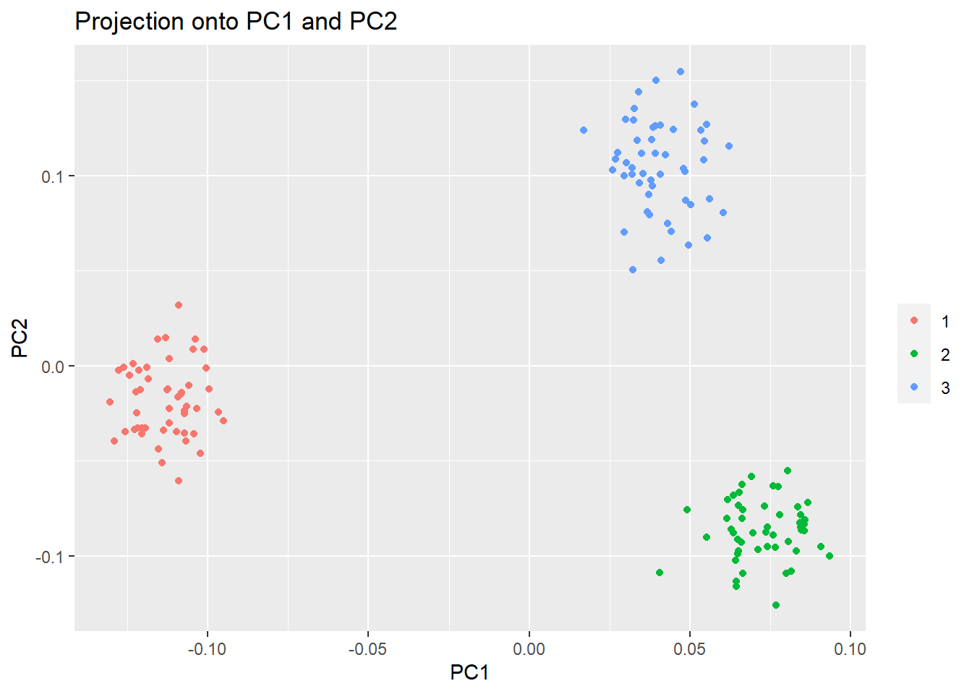
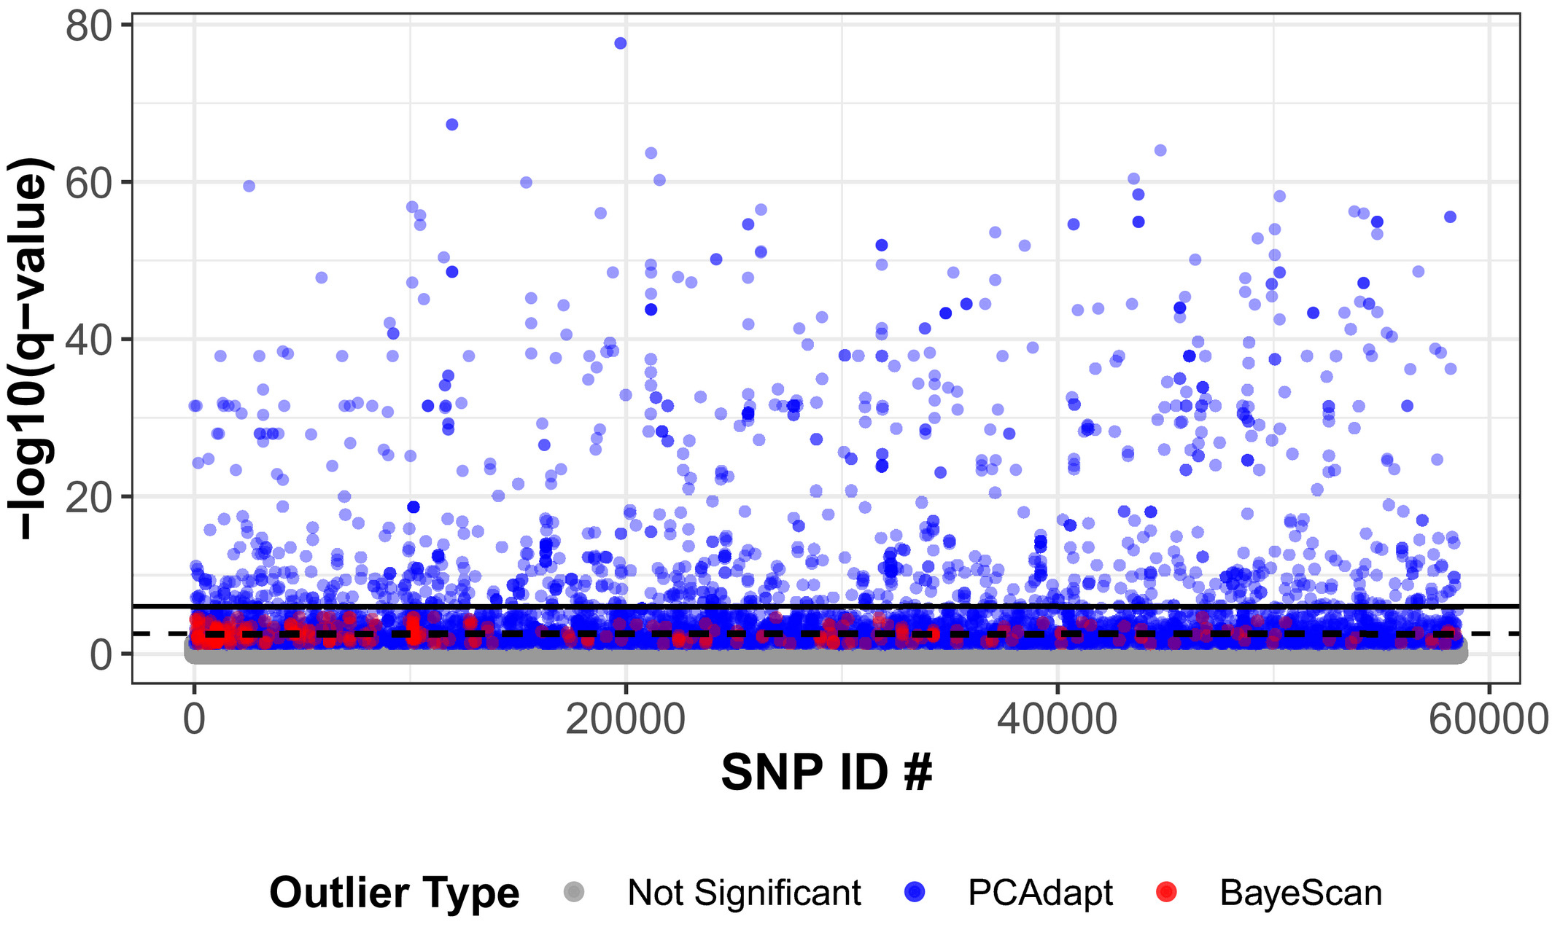
Detecting outlier regions
Estimate covariance/structure among all populations, look for outliers after correction
Baypass, bayenv2
PCAdapt
PCA based
Don’t need population assignments
markers excessively related to population structure are candidates for local adaptation
Reich et al., 2021
Luu, Bazin, Blum 2016

Slide 23
Types of selective sweeps
Haplotype diversity

Slide 24
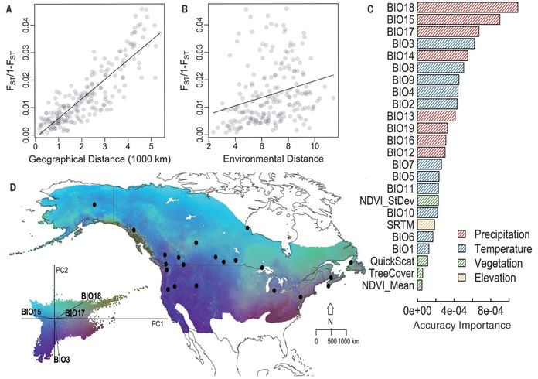
Gene environment associations
Where is there a correlation between the environment and genetics?
Important!
Must control for population structure!
Methods:
Bayenv2
latent factor mixed models: LFMM2
Machine learning
Gradient Forests, random forests

Slide 25
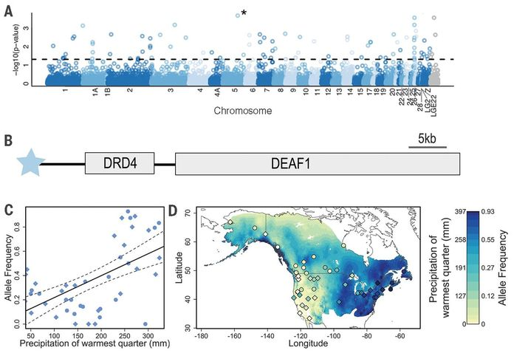

Slide 26
Detecting selection in genomic data
Outlier scans
Basic fst based
More complex:
Bayscan, outflank, etc.
Gene environment associations
Cline analyses
Experimental evolution
Before and after studies
Think hurricanes, sea star wasting, etc.

Slide 27
Types of selective sweeps
Haplotype diversity

Slide 28
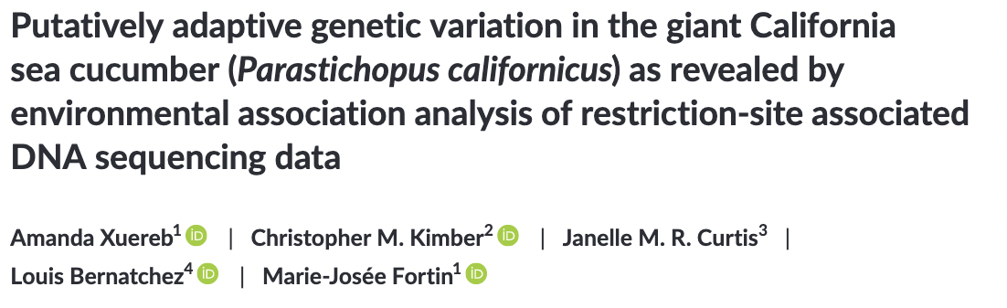
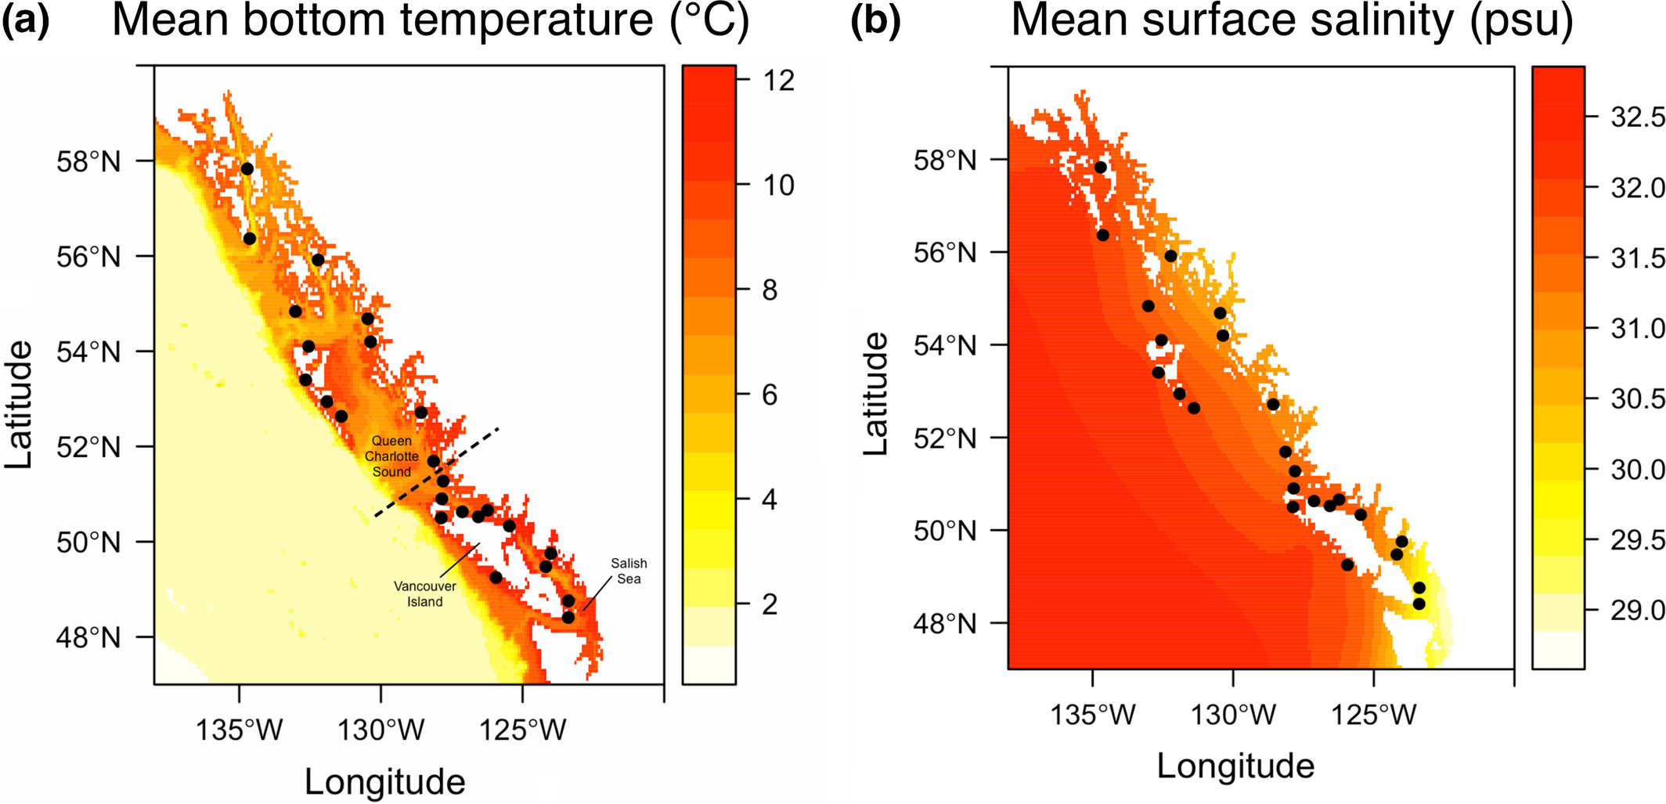

Slide 29
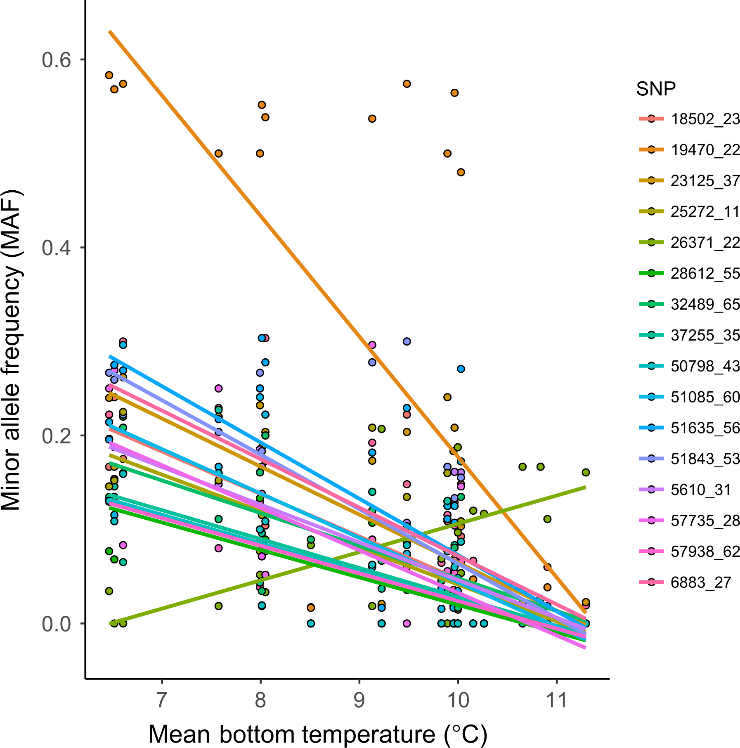
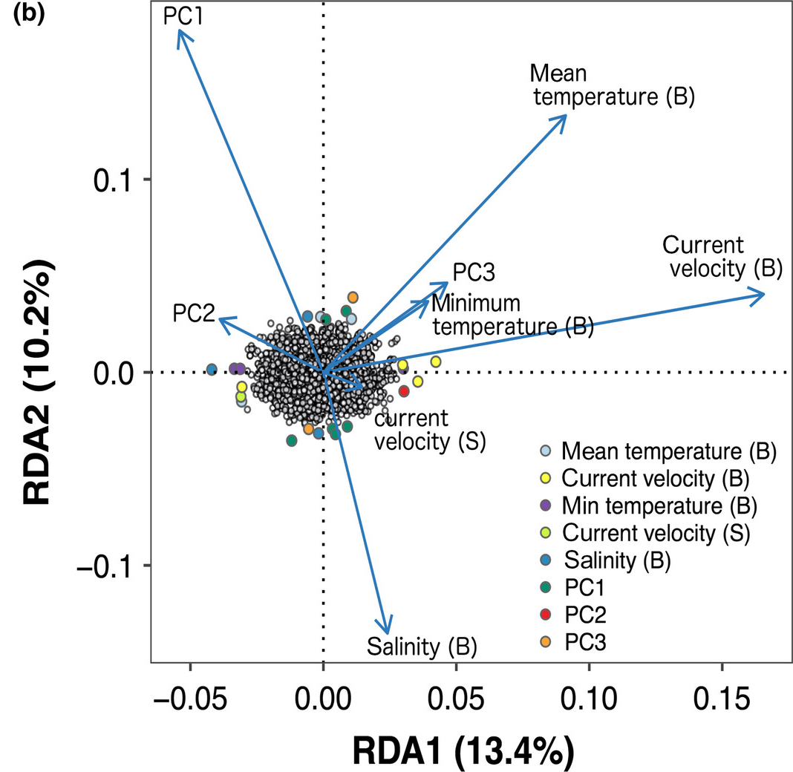

Slide 30
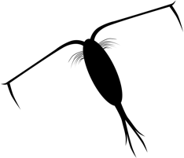
Experimental evolution/Evolve and resequence
Observe evolution as it happens
Look for consistent changes in allele frequencies

Slide 31
Experimental evolution/Evolve and resequence
Selection across generations
A
A
Selection
A
G
Drift
G
G
A
G
A
G
G
A
G
G
G
A
A
A
G
G
A
G
G
A
A
A
A
A
A
A
G
G
G
A
G
A
G
A
G
G
Allele frequency
G
G
A
Allele frequency
A
A
A
A
A
A
G
A
A
G
A
G
A
G
A
A
A
G
G
G
F0
F25
F0
F25

